Slide 1
Visual Studio 2010 and
.NET Framework 4
Name
Title
Microsoft Corporation
Notes:
The .NET Framework 4 release will include several enhancements to the framework that make application development easier. In this session, you’ll look at several sample applications that demonstrate how this release of the framework makes development easier. You’ll look at the new Managed Extensibility Framework, changes to the CLR and C# and VB, improvements to data access, services and workflow technologies. You’ll also see how enhancements to ASP.NET and Windows Presentation Foundation make building end-user applications easier.

Slide 2
A Look Back…
SP1
3.5
3.0
.NET 1.0
.NET 1.1
.NET 2.0
.NET 4
2002
2003
2005-08
2008 CTP
CLR 1.0
CLR 1.1
CLR 2.0
CLR 4

Slide 3
The .NET Framework
WPF
Win Forms
DLR
ASP.NET
WCF
LINQ
And more!
Base Class Libraries
The CLR
JIT & NGEN
Garbage Collector
Security Model
Exception Handling
Loader & Binder

Slide 4



Web Applications
Client Applications
Web Forms 4
AJAX 4
WPF 4
MEF
Client/Server
WCF 4
Notes:
Big news about Web Forms 4 is that Dynamic Data will be rolled into Web Forms 4 so it’s not a separate “project”\”assembly”\etc. with .NET 4

Slide 5

The Building Blocks…
Parallel Computing
Data Access
Task Parallel Library
Parallel LINQ
Entity Framework 4
Data Services 1.5
Runtime
DLR Integration
Type Equivalence
In-Process SxS

Slide 6
Web Forms 4 - Client ID
1) User Control (No ID)
2) User Control (“HeaderForm”)
3) Drop Down List (“States”)
Control Hierarchy
Resulting Client IDs:
ctl00
ctl00_HeaderForm
ctl00_HeaderForm_States

Slide 7
Web Forms 4 - Routing
Request:
Products/Bikes
ASP.NET Routing
Route:
Product/{name} -> Product.aspx
WebForms Page
File Name:
Product.aspx
Route Values:
Name = “Bikes”
Response

Slide 8

ASP.NET Web Forms 4 Client Id / Routing

Slide 9
WPF 4
Data Grid
Ribbon
Multi-Touch
Windows 7 Enhancements

Slide 10
Managed Extensibility Framework?
The Managed Extensibility Framework (MEF) is a new library in the .NET Framework that enables greater reuse of applications and components. Using MEF, .NET applications can make the shift from being statically compiled to dynamically composed
Notes:
MESSAGING:
New Library = just an assembly, a normal .dll, used by any .NET language
Dynamically Composed = composition takes place at runtime and composition behavior differs depending on how it is configured.

Slide 11
Open/Closed Principle
Software entities should be
open for extension,
but closed for modification.

Slide 12
Known vs. Unknown
Notes:
MESSAGING:
Due to it’s declarative-based and discovery-enabled approach, MEF becomes very powerful to use in an application where it is being used to put together a bunch of potentially unknown parts into a working application. You might also think about this as a 3rd party extending your application. When you are compiling your application (long before you ship), you have absolutely no idea on what sorts of extensions might be built for your application into the future. That’s the power of extensible applications, they can be extended and used in ways the original authors perhaps didn’t expect, or didn’t have the time to do themselves.
If you are concerned strictly with the “known” part of the equation (composing different software entities together that are all known at compile time), there are other solutions that are available today that are very powerful for this scenario: namely IoC containers (IoC = Inversion of Control). The Managed Extensibility Framework was designed primarily with the unknown aspect of extension in mind.

Slide 13
Client Applications WPF 4 DataGrid / MEF

Slide 14
Entity Framework 4
Model-First
POCO
Lazy Loading
Foreign Keys

Slide 15
A lot of new for WF/WCF 4
XAML-only workflows are the new default
Unified model between WF, WCF, and WPF
Extended base activity library
Simplified WF programming model
Support for arguments, variables, expressions
Major improvements to WCF integration
Runtime and designer improvements
Service discovery for WCF
Hosting & management via "Dublin“

Slide 16
ADO.NET Data Services 1.5
Server Enhancements
Row count
Server-side paging
Friendly feeds
BLOB streams
Client Enhancements
Row Count
WPF/SL data binding

Slide 17
ADO.NET Data Services Row Count and Server-Side Paging

Slide 18
The Parallel Computing Initiative
Letting the brightest developers solve business problems, not concurrency problems.
”Concurrency for the masses”
Notes:
MESSAGING:
Today, concurrency usually has to be done by the brightest developers in a business. The problem with this is that the brightest developers are then being consumed by concurrency minutia rather than being able to be focused on core business problems and helping the business’s bottom line. By providing new libraries and tools that make it easy to write parallel code, we hope to allow the best and brightest developers focus on the business problems at hand. This in turn enables other developers to be able to address concurrency and parallelism.
This is the long term goal of Microsoft with the Parallel Computing Initiative. Visual Studio 2010 and .NET Framework 4 is merely the first step being taken in this direction.

Slide 19
Parallel Computing with .NET 4
Task Parallel Library (TPL)
Parallel LINQ (PLINQ)
Coordination Data Structures (CDS)
System.Threading Improvements

Slide 20
Parallel LINQ
Parallel LINQ (PLINQ) enables developers to easily leverage manycore with a minimal impact to existing LINQ programming model
var q = from p in people
where p.Name == queryInfo.Name &&
p.State == queryInfo.State &&
p.Year >= yearStart &&
p.Year <= yearEnd
orderby p.Year ascending
select p;
.AsParallel()
Notes:
MESSAGING:
PLINQ is a technology that allows developers to _easily_ leverage manycore. The great thing about PLINQ is that if you are using LINQ-to-objects, there is a very minimal impact to your code in order for it to use PLINQ. All it takes to use PLINQ is adding “.AsParallel()” to your query. This will turn the query into a PLINQ query and will use the PLINQ execution engine when executed.
One small change, and your code now takes advantage of all the hardware available to you.
NOTES:
AsParallel() works by returning an IParallelEnumerable so every subsequent query operator works against the new IParallelEnumerable rather than the normal IEnumerable. See the hands-on lab for Parallel Extensions for more details.

Slide 21
Parallel Computing Parallel LINQ (PLINQ)

Slide 22
Why the DLR?
Dynamically-Typed
Ruby
Python
Statically-Typed
VB
C#
Common Language Runtime
Notes:
MESSAGING:
There is a good reason why the Dynamic Language Runtime (DLR) exists. The problem is that, today, dynamically-typed languages like Python and Ruby can’t easily run directly on top of the CLR as the CLR is primarily designed for statically-typed languages. By creating the DLR, we help plug that hole and allow dynamically-typed languages to run on top of the CLR (by working through the DLR).

Slide 23
Why the DLR?
Dynamically-Typed
Ruby
Python
Statically-Typed
VB
Dynamic Language Runtime
C#
Common Language Runtime
Notes:
MESSAGING:
The DLR provides core services that are necessary for dynamically-typed languages to work on the CLR
The DLR also provides other services that can be used by statically-typed languages as well to achieve more dynamic behavior:
Expression Trees (including Statements)
Dynamic Dispatch
Call Site Caching

Slide 24





.NET Dynamic Programming
IronPython
IronRuby
C#
VB.NET
Others…
Dynamic Language Runtime
Expression Trees
Dynamic Dispatch
Call Site Caching
Python Binder
Ruby Binder
Object Binder
JScript Binder
COM Binder
Notes:
MESSAGING:
The power of the DLR is that there are many binders for the DLR. Yes, we can interop with dynamic languages like Python and Ruby like we expect to. However, perhaps even more importantly, there are binders available for .NET, Silverlight, and Office. This allows us to interact between these platforms in very powerful ways that we were unable to currently.

Slide 25
Dynamically Typed Objects
Calculator calc = GetCalculator();
int sum = calc.Add(10, 20);
object calc = GetCalculator();
Type calcType = calc.GetType();
object res = calcType.InvokeMember("Add",
BindingFlags.InvokeMethod, null,
new object[] { 10, 20 });
int sum = Convert.ToInt32(res);
ScriptObject calc = GetCalculator();
object res = calc.Invoke("Add", 10, 20);
int sum = Convert.ToInt32(res);
Statically typed to be dynamic
dynamic calc = GetCalculator();
int sum = calc.Add(10, 20);
Dynamic conversion
Dynamic method invocation
Notes:
MESSAGING:
As long as we stay in our statically-typed world, interacting with objects is a pleasant and intuitive experience. However, as soon as you step out of that boundary and have to start using reflection, your code becomes much less elegant, harder to read, and harder to maintain.
Using ScriptObject in the DLR makes this a bit easier as it provides some direct method calls to invoke methods with specific parameters. And while this is an improvement, it’s still a departure from the way we are used to interacting with objects.
Using the new dynamic keyword in C# 4, we can call the .Add method above exactly as it were statically typed like in our first code snippet. In this case, the calc object is statically typed to be dynamic (yes, that’s true). Once we have a dynamic object references, we can dynamically invoke methods, do dynamic conversion, etc.

Slide 26
DLR Integration

Slide 27
Type Equivalence
Interop Assemblies translate between managed code and COM
For each interface, struct, enum,
delegate, and member, contains a
managed equivalent with marshalling data
Notes:
MESSAGING:
Office has thousands of APIs for addins exposed through COM. But COM was designed for native code. Interop Assemblies help “translate” between managed and native code by containing all the marshalling data necessary to make communication possible.

Slide 28
However!
Primary Interop Assemblies cause many pain points…
Notes:
MESSAGING:
Let’s look at Office as an example. Add-ins in Excel, for instance, may very well need to talk to each other -> Because they have to talk to each other, they have to be using the same types for Excel -> Because of the way the type system works in the CLR, these types must also be in the same assembly -> So, the assembly is required to be in a common location (e.g. the GAC) in order for the add-ins to function properly.
Well, Office currently does not require the .NET Framework to be installed on a machine. If a machine doesn’t have .NET installed, there’s no GAC, and hence nothing to deploy the PIA into. Herein lies the problem. Even if an add-in is only using a single function, enum, etc. from the interop assembly, the add-in must deploy the entire PIA along with itself. Office PIA is around 10-20mb, it’s HUGE. So you might have a 100k add-in “bringing along” a 20mb PIA.

Slide 29
Go Away, PIA!
Compilers embed the portions of the interop assemblies that the add-ins actually use
Runtime ensures the embedded definitions of these types are considered equivalent
Notes:
MESSAGING:
There are two primary things that enable PIAs to be buried, forever, never to rise again.
Compiler enhancements (this embedding works down to the method level even, so even a full interface is not required).
Runtime enhancements
Even though they are in different assemblies
Even though they may have different subsets
Hence, type equivalence allows two interfaces, enums, delegates and plain-old-data-structures to mark themselves as equivalent with each other.

Slide 30
CLR 4 Type Equivalence

Slide 31
.NET Framework Compatibility
.NET 4.0 is a highly compatible release
.NET 4.0 does not auto–roll forward
You must add a configuration file with a specific switch to get 3.5 apps to run on 4.0

Slide 32
.NET Framework Compatibility
Hang on… if 4.0 is compatible, why not run 3.5 apps automatically on 4.0?
The BEST thing is always to prefer running on the version of the framework you built against

Slide 33

CLR 2 - Existing Side-By-Side
2.0 add-in
3.0 add-in
3.5 add-in
1.1 add-in
3.5
3.0
.NET 1.1
.NET 2.0
Host Process (i.e. Outlook)
Notes:
MESSAGING:
Side X Side releases solve app compat issue
COM objects and other addins for different layers of the same cake can easily live together on the same runtime
Highly compatible – but only certain kinds of functionality can be added

Slide 34
CLR 4 - In-Process Side-By-Side
2.0 add-in
3.0 add-in
3.5 add-in
4.0 add-in
3.5
.NET 4.0
3.0
.NET 2.0
Host Process (i.e. Outlook)
Notes:
MESSAGING:
Run both 2.0-based and 4.0-based CLR in the same process
Old components use old CLR
New components use new CLR
Configuration file and hosting APIs give you fine-grained control

Slide 35
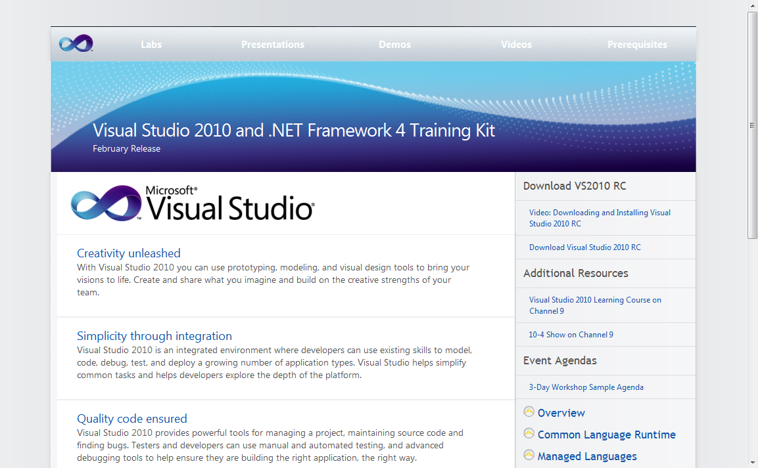
Visual Studio 2010 Training Kit
Download at http://tinyurl.com/vs2010trainingkit

